Slide 1
Radar Project
Presented by-- Simuk Arya

Slide 2
Flow of project
Matched Filtering
Windowing
Doppler Processing
Maximizes the peak SNR Done by convolution of received pulse with time reversed LFM(transmit pulse). | Reduces sidelobes of strong targets so that we can detect targets hidden under those sidelobes This is done by multiplying the windowing function with the data. Also it gives tapering effect to the data. | Converting time domain signals to frequency domain. Can be done by applying fft on the data.

Slide 3
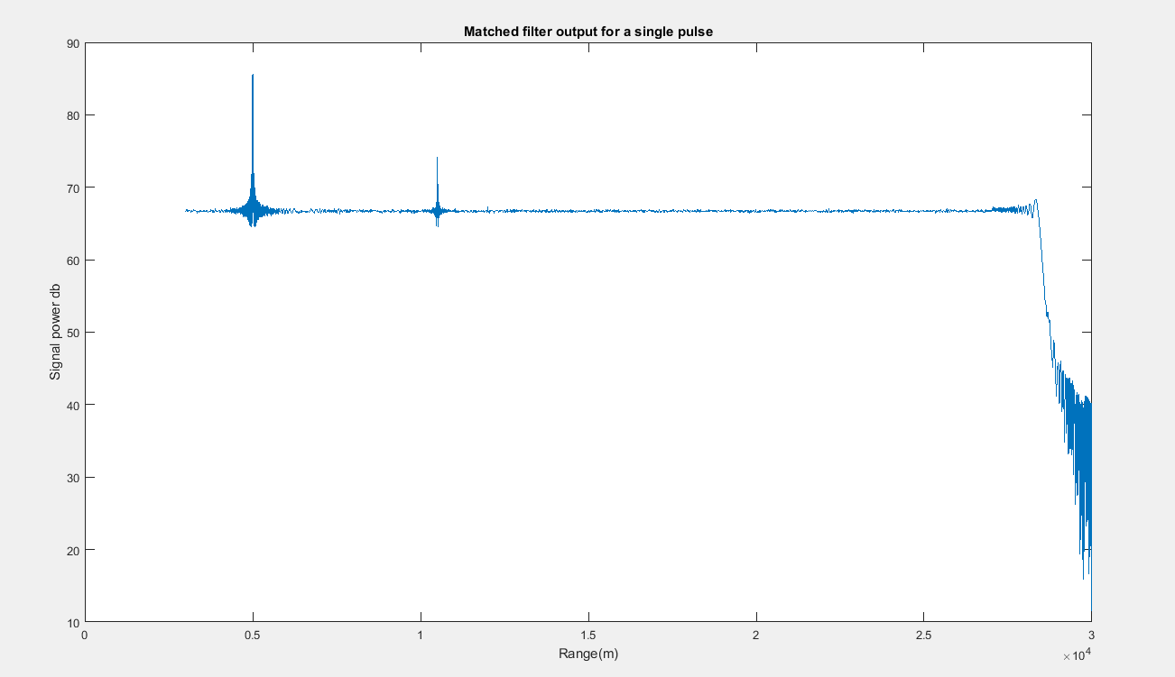
Graph 1- Matched filter output

Slide 4
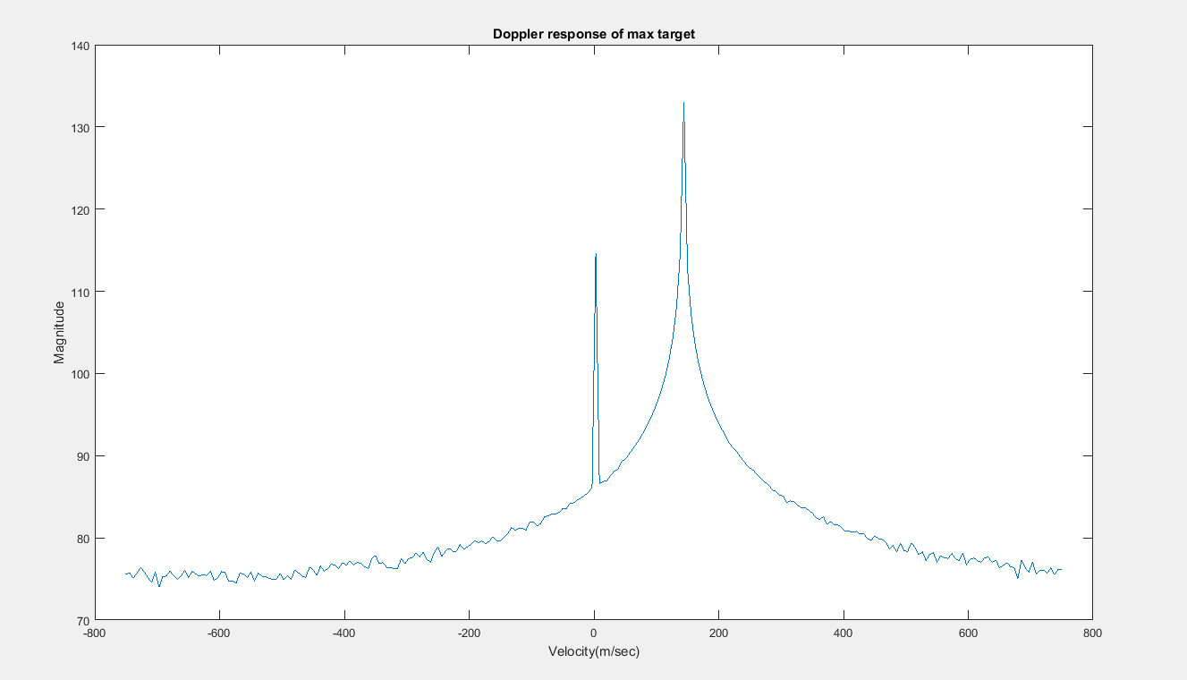
Graph 2- Doppler response of max target Max target Details– Velocity-144.1 and Magnitude-132.5

Slide 5
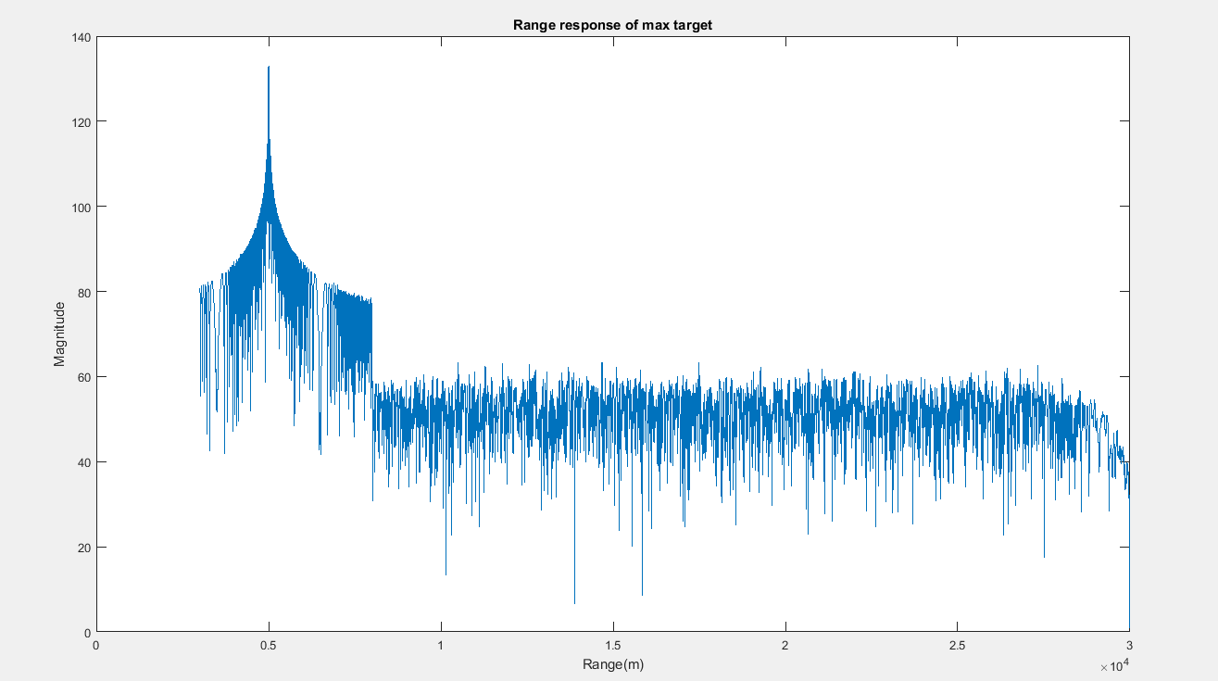
Graph 3- Range response of max target Max target Details– Range-0.49*10^4 and Magnitude-132.5

Slide 6
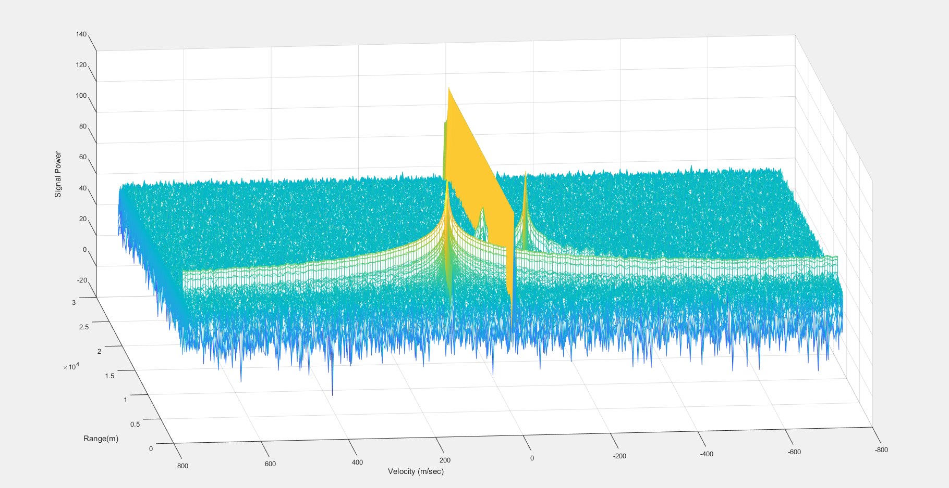
Graph 4- Surface plot of range vs Doppler (Total 3 targets detected)

Slide 7
Range, Speed and Signal power of each target:
 | Range | Speed | Signal power
Target 1 | 4.9*10^3 (metre) | 144.1 (m/sec) | 132.5
Target 2 | 1.2*10^4 (metre) | 20.59 (m/sec) | 89.97
Target 3 | 1.05*10^4 (metre) | -67.65 (m/sec) | 118.1

Slide 8
Thank you

